Slide 1





HEPATITIS B MANAGEMENT
(ACUTE)
TREATMENT
….
INTRODUCTION
….
DIAGNOSIS
….
TRANSMISSION & PREVENTION
….
SYMPTOMS & SIGNS
….

Slide 2

Hepatitis B virus (HBV) is a virus, made up of the genetic material, double stranded DNA.
HBV belongs to the family, hepadnaviridae.
INTRODUCTION
….

Slide 3

Approximately, two billion people worldwide have evidence of past or present infection with hepatitis B virus (HBV).
That is - about 1 out of every 4 person in the world has been exposed to HBV!
INTRODUCTION
….

Slide 4


About 300 million persons are chronically infected, of whom more than 500,000 die per year.
INTRODUCTION
….
i.e., about 2 out of 1000 HBV patients die annually

Slide 5


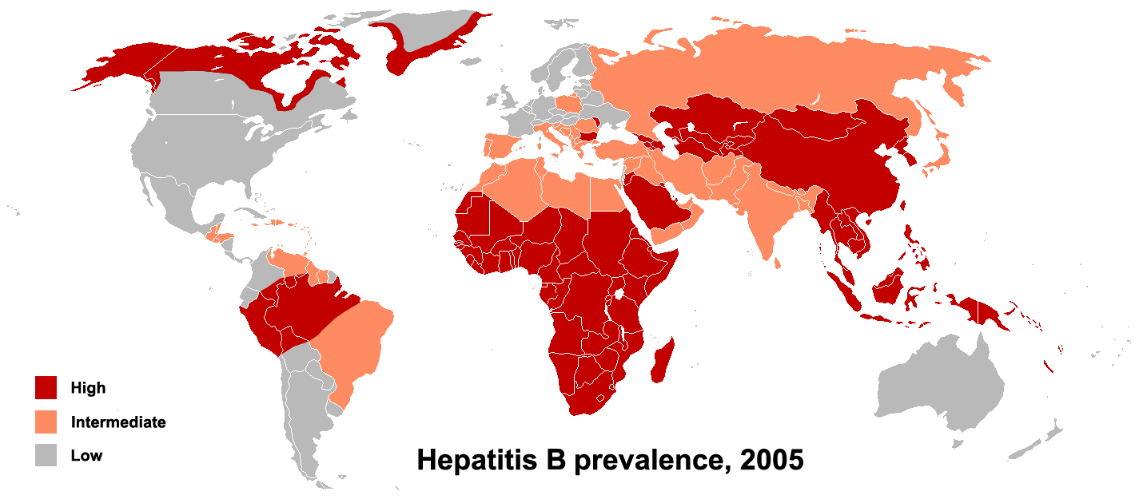
The overall global prevalence is 3.5%, showing very low rates in developed western world and high rates of up to 10% in Africa and Asia.
Deaths are due to HBV-related liver diseases, such as cirrhosis and liver cancer (hepatocellular carcinoma)
INTRODUCTION
….

Slide 6

INTRODUCTION
….
Decisions about the management of patients with HBV should be based on clinical information and investigation (tests) outcomes.
The next few slides will dwell on the management of adults with hepatitis B virus infection

Slide 7

Types of infection of HBV:
Acute HBV infection
Chronic HBV infection
INTRODUCTION
….
Do you have an idea what makes one hepatitis B acute, and the other, chronic?

Slide 8

Acute HBV is when the infection lasts within a 6-month period
Whereas chronic hepatitis B infection is defined as persistence of HBV infection beyond 6 months
INTRODUCTION
….
It is based on duration!

Slide 9

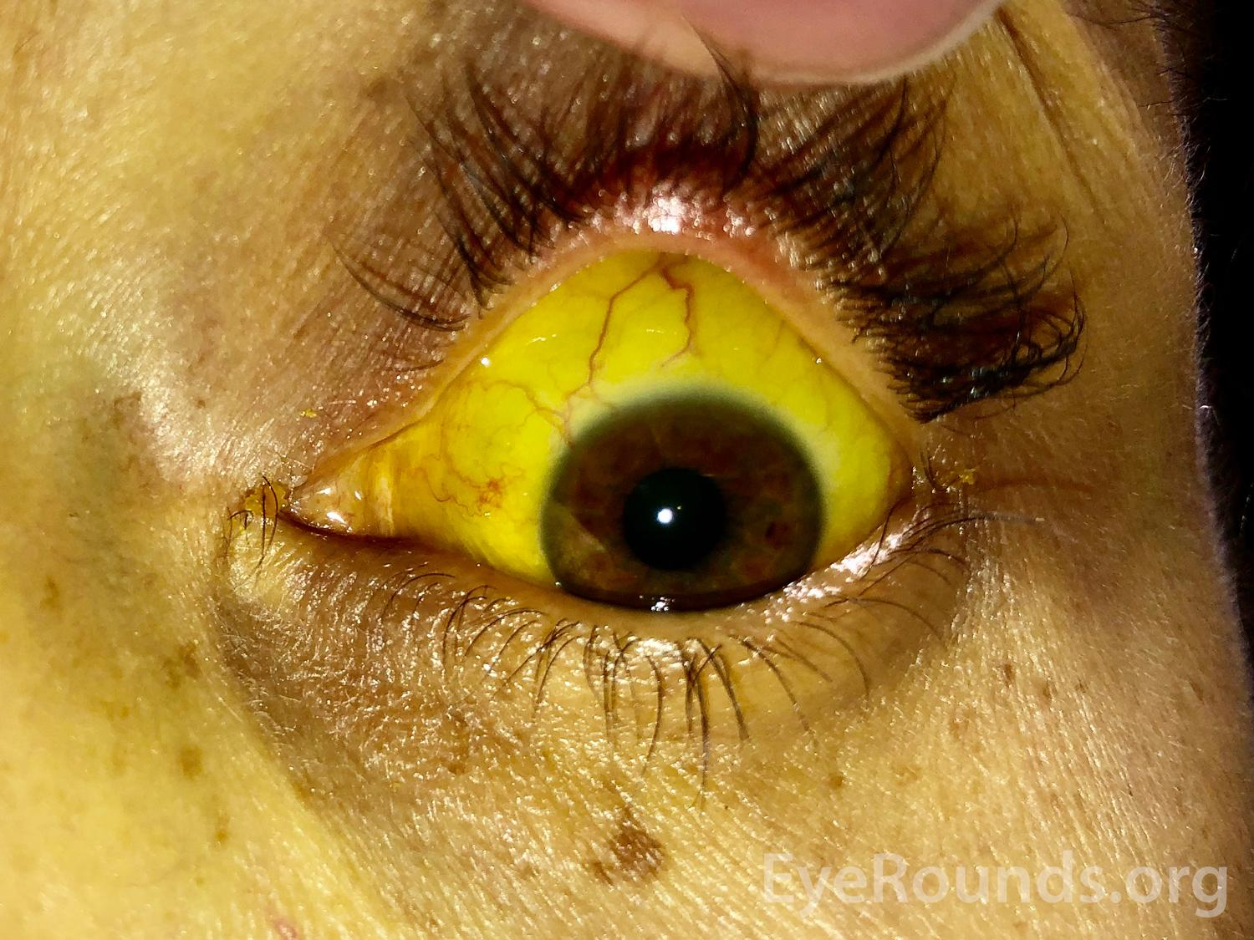

During acute infection, clinical manifestations include
-subclinical disease (otherwise called anicteric hepatitis)
-icteric hepatitis and in some cases,
-fulminant inflammation of the liver.
INTRODUCTION
….

Slide 10
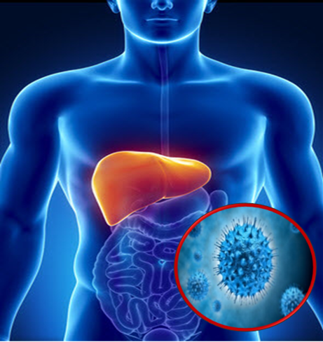
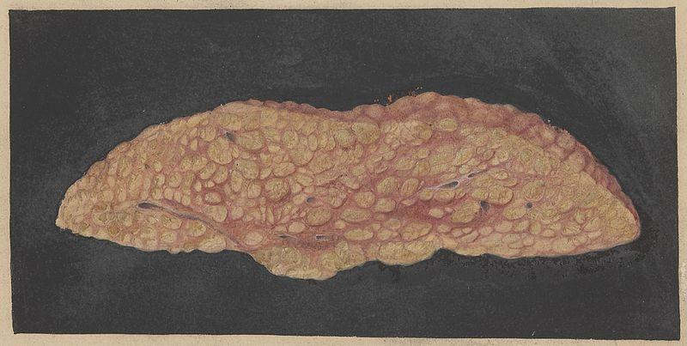
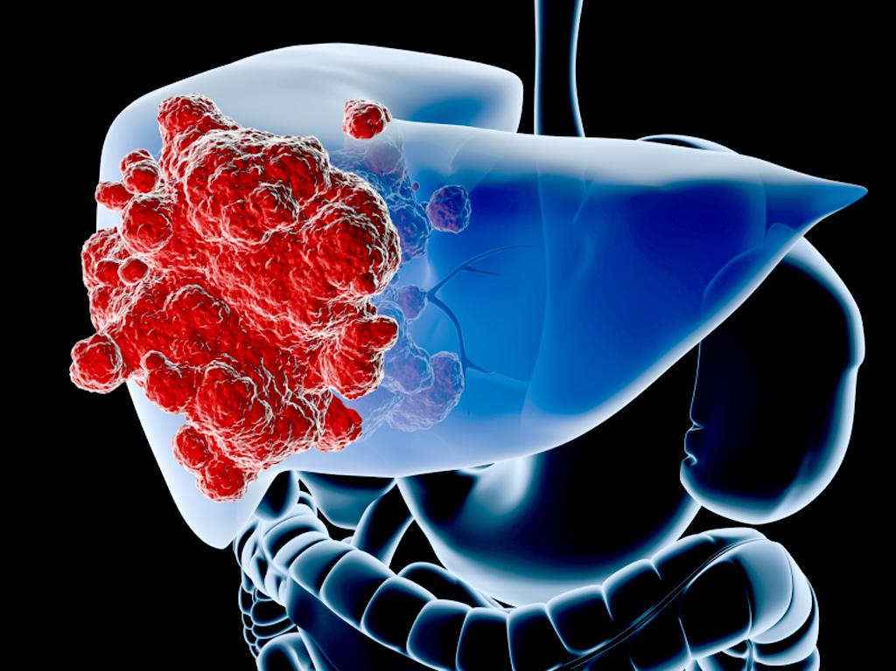
Chronic HBV manifests by asymptomatic carrier state to chronic hepatitis (what used to be called chronic active hepatitis), cirrhosis and hepatocellular carcinoma.
INTRODUCTION
….

Slide 11
Although the predominant organ of HBV infection is the liver, the disease can present with symptoms that are not directly due to the liver inflammation (extrahepatic manifestations)
Extrahepatic manifestations can occur in both acute and chronic infection.
INTRODUCTION
….

Slide 12

The predominant mode of transmission of hepatitis B varies with geographical location
In regions that have a high rate of HBV infection, the most common mode of transmission is mother to child whilst sexual and intravenous routes are the most documented in low prevalence areas
TRANSMISSION
….

